Slide 1

LIST

Slide 2
SESSION OVERVIEW:
DEFINITION
CREATION
ACCESS & SLICING
DELETION
METHODS & BUILT-IN FUNCTIONS
OPERATIONS
COMPREHENSION

Slide 3

DEFINITION
A List is Created by placing all the elements inside a Square Bracket [ ] separated by commas ,
A List can have any number of elements even of Different Data Types.
SYNTAX :
<variable_name> = [element1,element2,…..]

Slide 4




A List can have another List in it ,called as Nested List

Slide 5
ACCESSING
We Use the Index Operator [ ] to access an element in the list.
Index Starts From 0
A list Having 5 Elements will have the Index from 0 to 4.
A = | A | P | P | L | E
POSITIVE | 0 | 1 | 2 | 3 | 4
NEGATIVE | -5 | -4 | -3 | -2 | -1

Slide 6
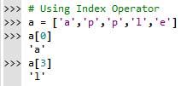
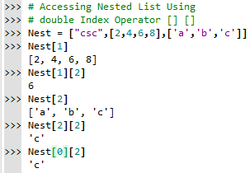
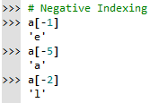

Slide 7


ERRORS !
Index Error : Trying to Access an Element out of the Range
Type Error : Index Value Other than Integer

Slide 8
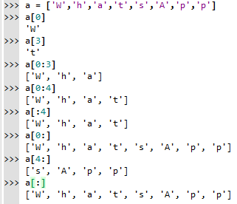
SLICING
Slicing operator (:) – To Access a Range of Items in a List

Slide 9
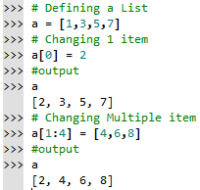
CHANGING VALUES
In Python, the lists are mutable, which means they can be changed.
A list element or range of elements can be changed or altered by using simple assignment operator (=).
SYNTAX:
List_Variable [index of an element] = Value to be changed
List_Variable [index from : index to] = Values to changed

Slide 10
ADDING ELEMENTS
append() – to add 1 item at last
extend() – to add more than 1 item at the last
+ Operator – to combine 2 lists
insert() – to add 1 item at desired location
Slicing Operator - to add more than 1 item at the desired Location

Slide 11
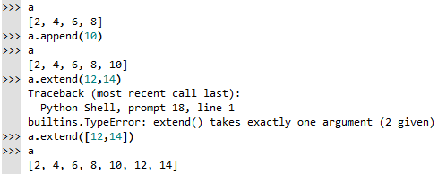
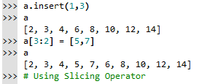

Slide 12
DELETION
del – to delete 1 or more items & also the list itself
remove() – to delete using the value
pop() – to delete using the index & returns the value
clear() – to delete all the items but not the list itself
Empty List [] – to delete by assigning null values

Slide 13
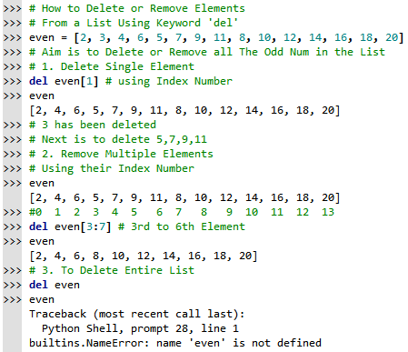

Slide 14
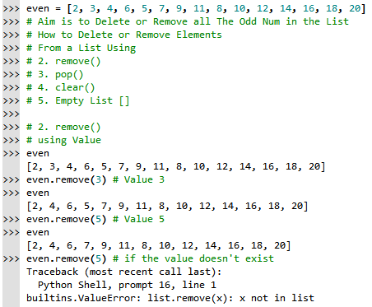

Slide 15
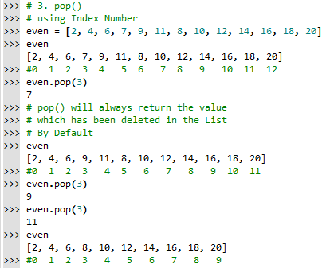

Slide 16
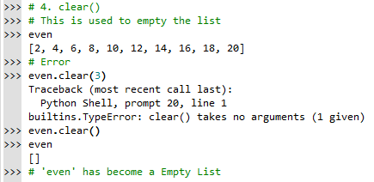
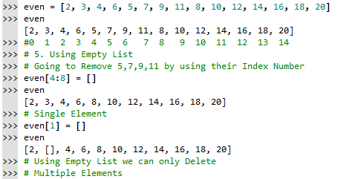

Slide 17
METHODS
index() – Returns the Index value of the first Matched element
count() – No of Times the given Value is Repeated in the list
sort() – to Sort the given list in Ascending Order
reverse() - to sort in Descending Order
copy() – to copy the values in a list to another list

Slide 18
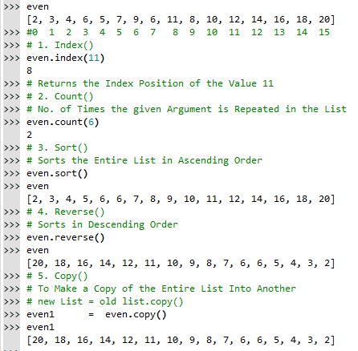

Slide 19
BUILT-IN FUNCTIONS
all() – Returns True if all the items are True(values other than zero ‘0’) or empty. ≈ Logical And
any() – Returns True if any 1 items is True(values other than zero ‘0’) ≈ Logical Or . If Empty then False

Slide 20
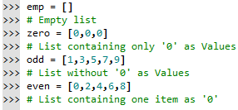
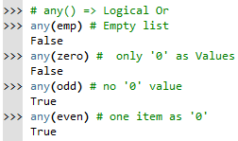
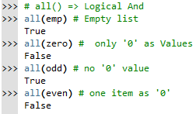

Slide 21
enumerate() - Returns the list as Values followed by their Index Number.
len() – returns the Length of the list( no. of items in it)
list() – to convert the other datatypes into List
max() – greatest value in the list
min() – smallest value in the list
sum() – adds all the value in the list & returns it
sorted() – Returns a New Sorted List . * NOTE it does not sort the list itself

Slide 22
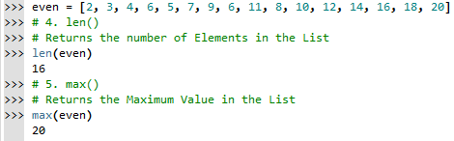
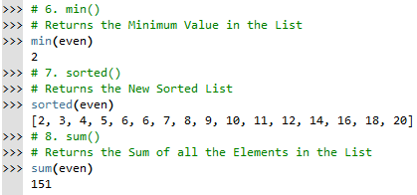

Slide 23
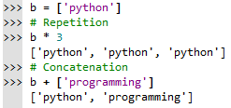
LIST OPERATIONS
Repetition & Concatenation
Membership Test
Iteration

Slide 24
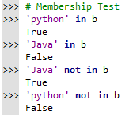
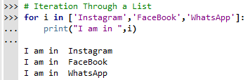

Slide 25
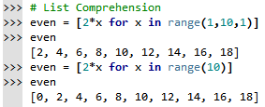
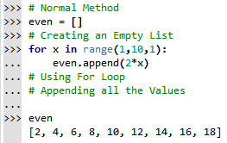
COMPREHENSION

Slide 26

CODING IS FUN ! THANK YOU !!

